Slide 1
Analog Data Transmission

Slide 2
Analog Transmission
An Analog transmission is a transmission method of conveying information such as voice, data, video, image etc. using a continuous signal which vary in amplitude , phase or some other property proportion to that of a variable.

Slide 3
While digital transmission is very desirable, a low-pass channel is needed and analog transmission is the only choice if we have a band pass channel.
Converting digital data to a band pass analog signal is traditionally called digital to- analog conversion.
Converting a low-pass analog signal to a band pass analog signal is traditionally called analog-to-analog conversion.

Slide 4
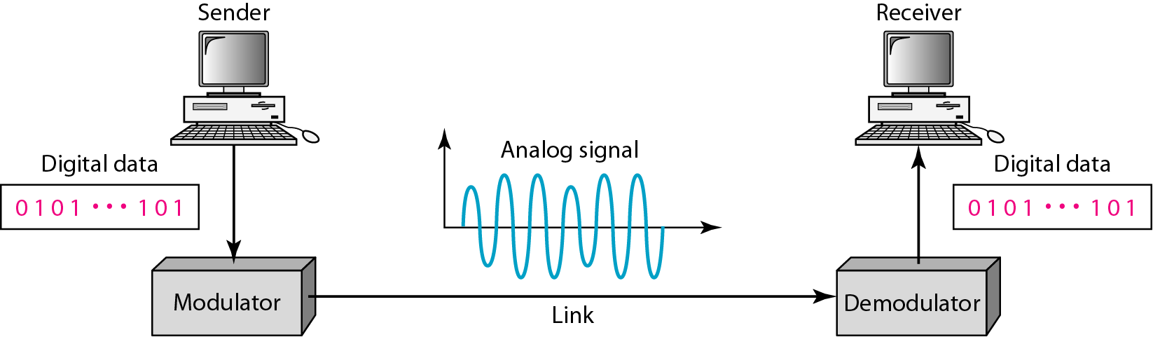
DIGITAL TO ANALOG CONVERSION
Digital-to-analog conversion is the process of changing one of the characteristics of an analog signal based on the information in digital data.

Slide 5
Digital to Analog Conversion
Digital data needs to be carried on an analog signal.
A carrier signal (frequency f_{c}) performs the function of transporting the digital data in an analog waveform.
The analog carrier signal is manipulated to uniquely identify the digital data being carried.

Slide 6
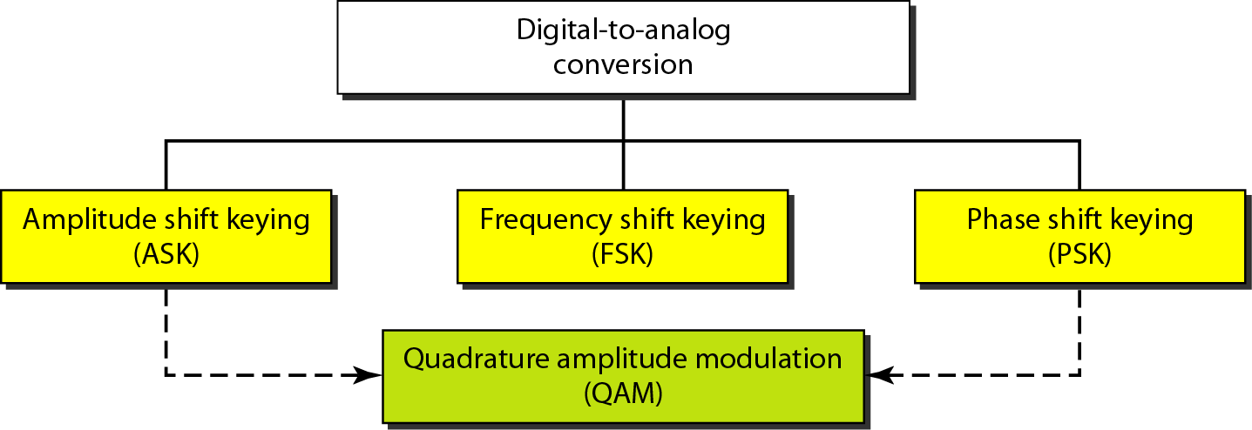
Types of digital-to-analog conversion

Slide 7
A sine wave is defined by three characteristics: amplitude, frequency, and phase.
When varying anyone of these characteristics, a different version of that wave is created. So, by changing one characteristic of a simple electric signal, digital data is represented.
Any of the three characteristics can be altered in least three mechanisms for modulating digital data into an analog signal:
  amplitude shift keying (ASK)
  frequency shift keying (FSK)
  phase shift keying (PSK).
In addition, there is a fourth (and better) mechanism that combines changing both the amplitude and phase, called quadrature amplitude modulation (QAM). QAM is the most efficient of these options and is the mechanism commonly used today.

Slide 8
Bit rate, N, is the number of bits per second (bps).
Baud rate is the number of signal elements per second (bauds).
In the analog transmission of digital data, the signal or baud rate is less than or equal to the bit rate.
S=Nx1/r bauds
Where r is the number of data bits per signal element.

Slide 9
Amplitude Shift Keying (ASK)
ASK is implemented by changing the amplitude of a carrier signal to reflect amplitude levels in the digital signal.
For example: a digital “1” could not affect the signal, whereas a digital “0” would, by making it zero.
The line encoding will determine the values of the analog waveform to reflect the digital data being carried.

Slide 10
Bandwidth of ASK
The bandwidth B of ASK is proportional to the signal rate S.
B = (1+d)S
“d” is due to modulation and filtering, lies between 0 and 1.

Slide 11
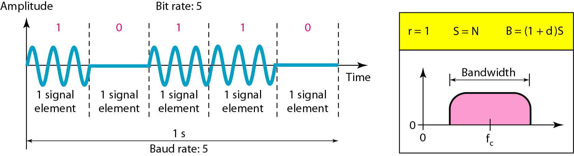
Binary amplitude shift keying(BASK)/ On-Off Keying(OOK)

Slide 12
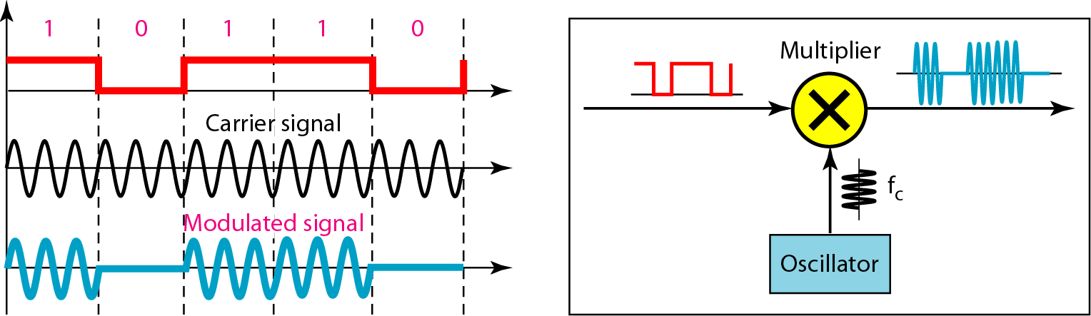
Implementation of binary ASK

Slide 13
Frequency Shift Keying
The digital data stream changes the frequency of the carrier signal, f_{c}.
For example, a “1” could be represented by f₁=f_{c} +Δf, and a “0” could be represented by f₂=f_{c}-Δf.

Slide 14
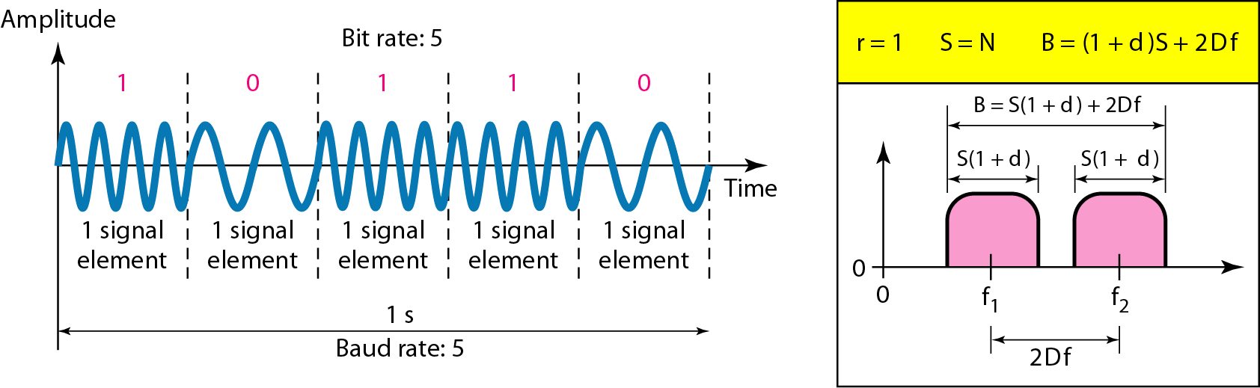
Binary frequency shift keying

Slide 15
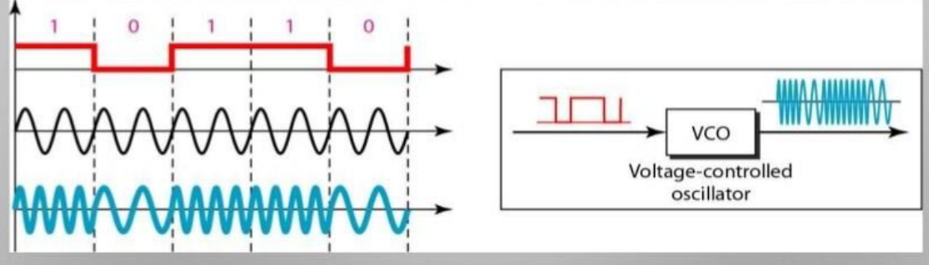
Implementation of BFSK

Slide 16
Bandwidth of FSK
If the difference between the two frequencies (f₁ and f₂) is 2Δf, then the required BW B will be:
B = (1+d)xS +2Δf

Slide 17
Coherent and Non Coherent
In a non-coherent FSK scheme, when we change from one frequency to the other, we do not adhere to the current phase of the signal.
In coherent FSK, the switch from one frequency signal to the other only occurs at the same phase in the signal.

Slide 18
Multi level FSK
Similarly to ASK, FSK can use multiple bits per signal element.
That means we need to provision for multiple frequencies, each one to represent a group of data bits.
The bandwidth for FSK can be higher
B = (1+d)xS + (L-1)/2Δf = LxS

Slide 19
Phase Shift Keying
We vary the phase shift of the carrier signal to represent digital data.
The bandwidth requirement, B is:
B = (1+d)xS
PSK is much more robust than ASK as it is not that vulnerable to noise, which changes amplitude of the signal.

Slide 20
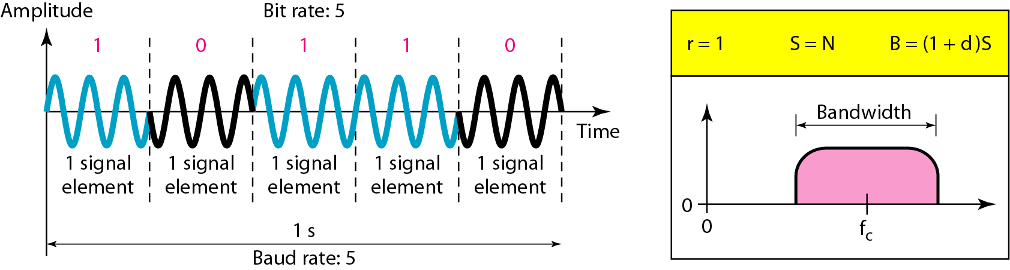
Binary phase shift keying

Slide 21
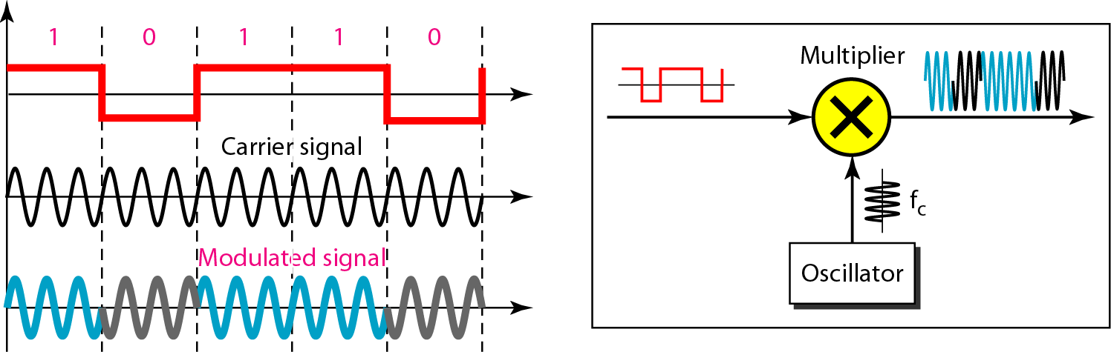
Implementation of BASK

Slide 22
Quadrature PSK
To increase the bit rate, we can code 2 or more bits onto one signal element.
In QPSK, we parallelize the bit stream so that every two incoming bits are split up and PSK a carrier frequency. One carrier frequency is phase shifted 90º from the other - in quadrature.
The two PSKed signals are then added to produce one of 4 signal elements. L = 4 here.

Slide 23
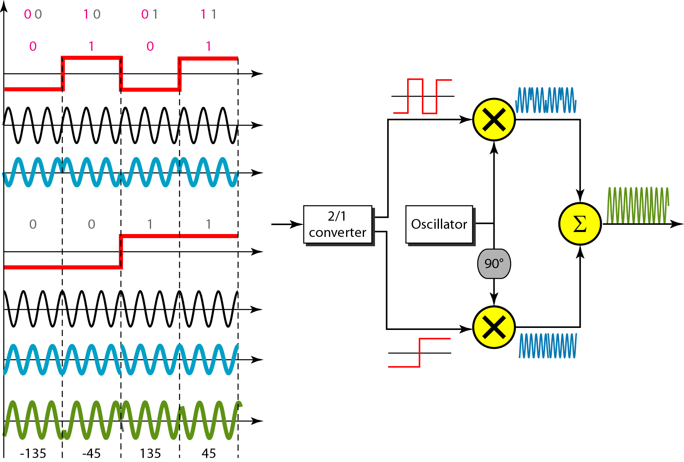
QPSK and its implementation

Slide 24
Constellation Diagrams
A constellation diagram helps us to define the amplitude and phase of a signal when we are using two carriers, one in quadrature of the other.
The X-axis represents the in-phase carrier and the Y-axis represents quadrature carrier.

Slide 25
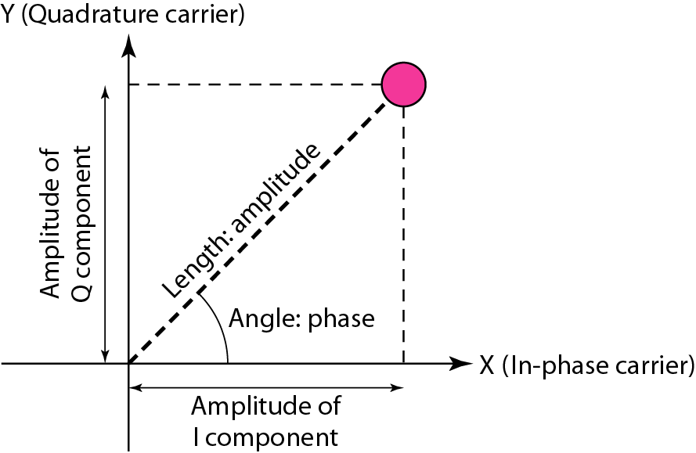
Concept of a constellation diagram

Slide 26
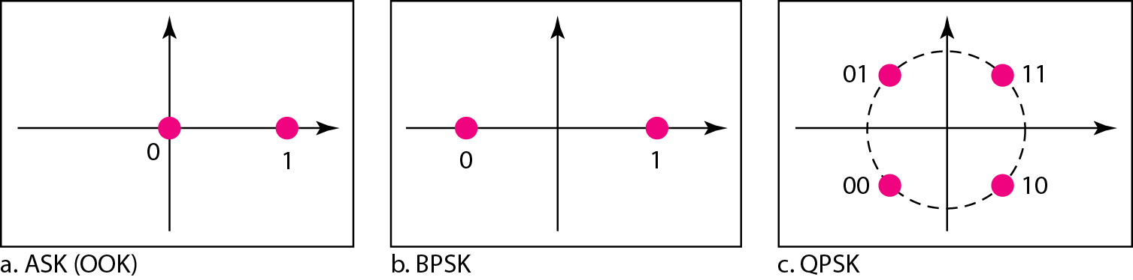
Three constellation diagrams

Slide 27
For ASK, we are using only an in-phase carrier. Therefore, the two points should be on the X axis. Binary 0 has an amplitude of 0 V; binary 1 has an amplitude of 1V (for example). The points are located at the origin and at 1 unit.
BPSK also uses only an in-phase carrier. However, we use a polar NRZ signal for modulation. It creates two types of signal elements, one with amplitude 1 and the other with amplitude -1. This can be stated in other words: BPSK creates two different signal elements, one with amplitude I V and in phase and the other with amplitude 1V and 1800 out of phase.
QPSK uses two carriers, one in-phase and the other quadrature. The point representing 11 is made of two combined signal elements, both with an amplitude of 1 V. One element is represented by an in-phase carrier, the other element by a quadrature carrier. The amplitude of the final signal element sent for this 2-bit data element is 2112, and the phase is 45°. The argument is similar for the other three points. All signal elements have an amplitude of 2112, but their phases are different (45°, 135°, -135°, and -45°). Of course, we could have chosen the amplitude of the carrier to be 1/(21/2) to make the final amplitudes 1 V.

Slide 28
Quadrature amplitude modulation
Quadrature amplitude modulation is a combination of ASK and PSK.

Slide 29
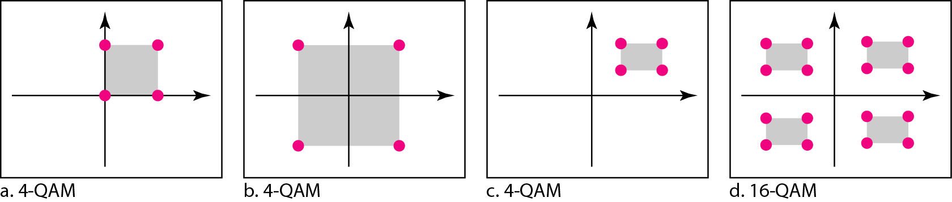
Constellation diagrams for some QAMs

Slide 30
Analog-to-analog conversion
Analog-to-analog conversion is the representation of analog information by an analog signal.
This modulation is needed if the medium is band pass in nature or if only a band pass channel is available to us. An example is radio.
The government assigns a narrow bandwidth to each radio station.
The analog signal produced by each station is a low-pass signal, all in the same range.
To be able to listen to different stations, the low-pass signals need to be shifted, each to a different range.

Slide 31
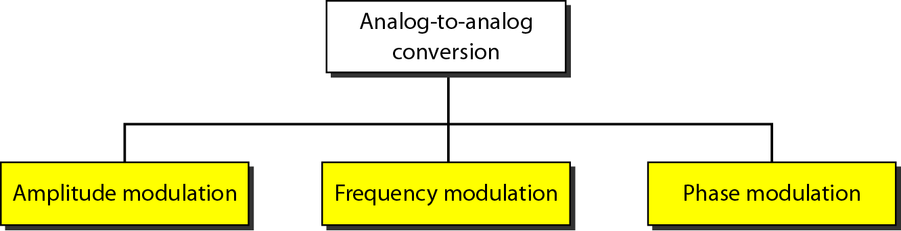
Types of analog-to-analog modulation

Slide 32
Amplitude Modulation
A carrier signal is modulated only in amplitude value
The carrier signal is modulated so that its amplitude varies with the changing amplitudes of the modulating (audio) signal.
The frequency and phase of the carrier remain the same, only the amplitude changes to follow variations in the information.
The modulating signal is the envelope of the carrier
The required bandwidth is 2B, where B is the bandwidth of the modulating signal
Since on both sides of the carrier freq. f_{c}, the spectrum is identical, we can discard one half, thus requiring a smaller bandwidth for transmission.

Slide 33
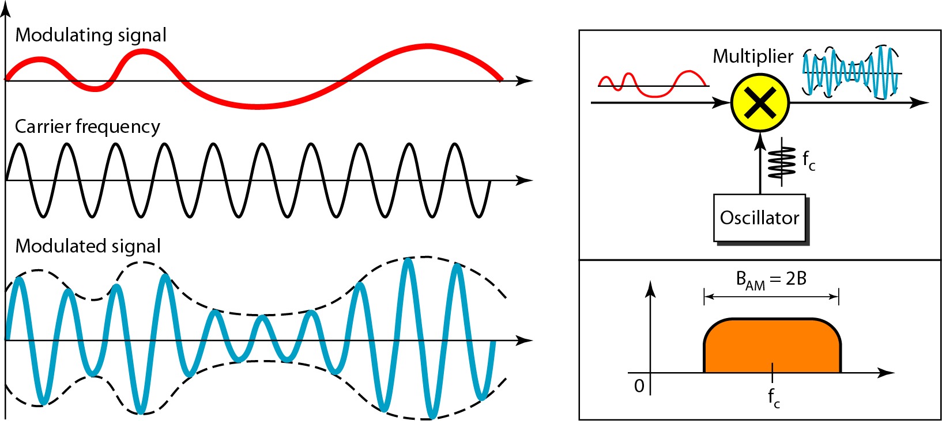
Amplitude modulation

Slide 34
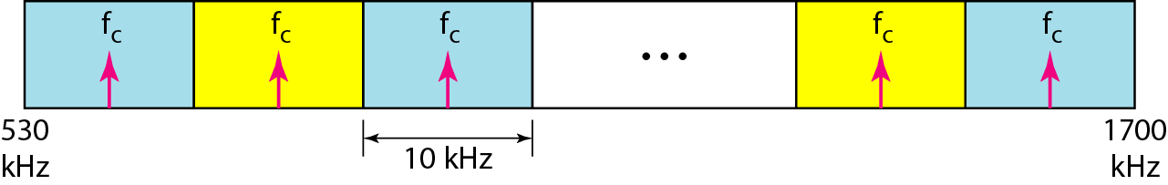
The total bandwidth required for AM can be determined from the bandwidth of the audio signal: B_{AM} = 2B.
AM band allocation

Slide 35
Frequency Modulation
The modulating signal changes the freq. f_{c} of the carrier signal
The frequency of the carrier signal is modulated to follow the changing voltage level (amplitude) of the modulating signal.
The peak amplitude and phase of the carrier signal remain constant, but as the amplitude of the information signal changes, the frequency of the carrier changes correspondingly.
The bandwidth for FM is high
It is approx. 10x the signal frequency
The total bandwidth required for FM can be determined from the bandwidth of the audio signal:
B_{FM} = 2(1 + β)B. Where β is usually 4.

Slide 36
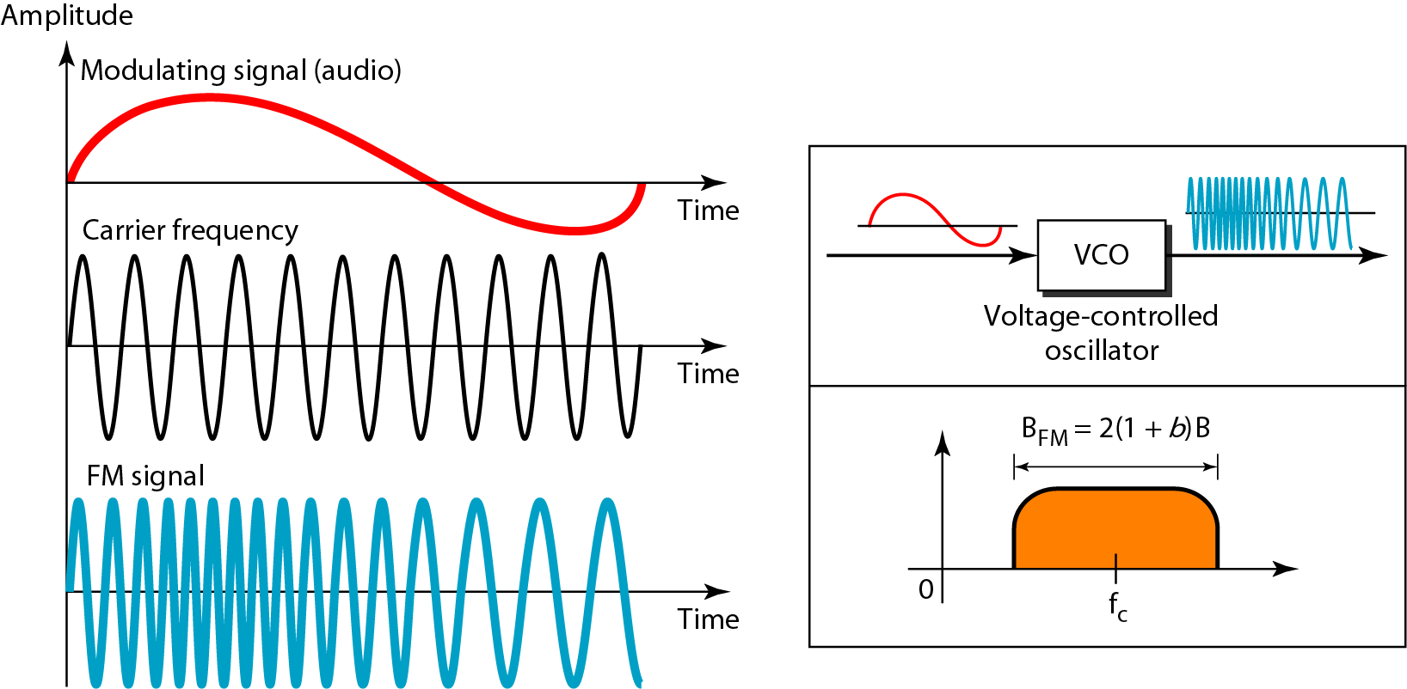
Frequency modulation

Slide 37
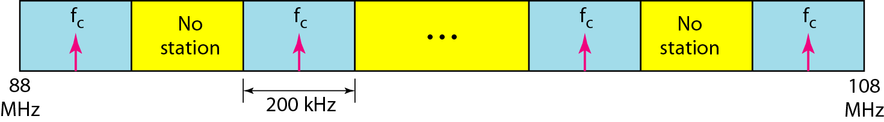
FM band allocation

Slide 38
Phase Modulation (PM)
The modulating signal only changes the phase of the carrier signal.
In PM transmission, the phase of the carrier signal is modulated to follow the changing voltage level (amplitude) of the modulating signal.
The peak amplitude and frequency of the carrier signal remain constant, but as the amplitude of the information signal changes, the phase of the carrier changes correspondingly.
The phase change manifests itself as a frequency change but the instantaneous frequency change is proportional to the derivative of the amplitude.
The bandwidth is higher than for AM.

Slide 39
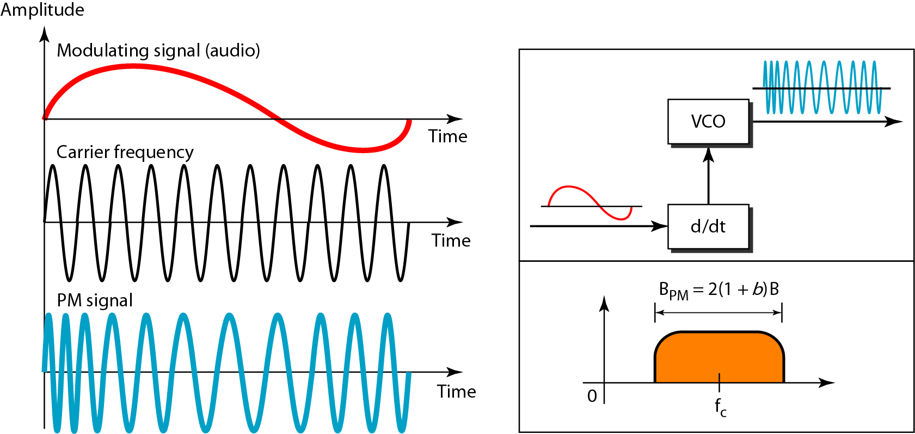
Phase modulation

Slide 40
The total bandwidth required for PM can be determined from the bandwidth and maximum amplitude of the modulating signal:
B_{PM} = 2(1 + β)B Where β = 2 most often.

